Slide 1

Francesco Musso, Davide Ponassi
ADM Project 2018/2019

Slide 2
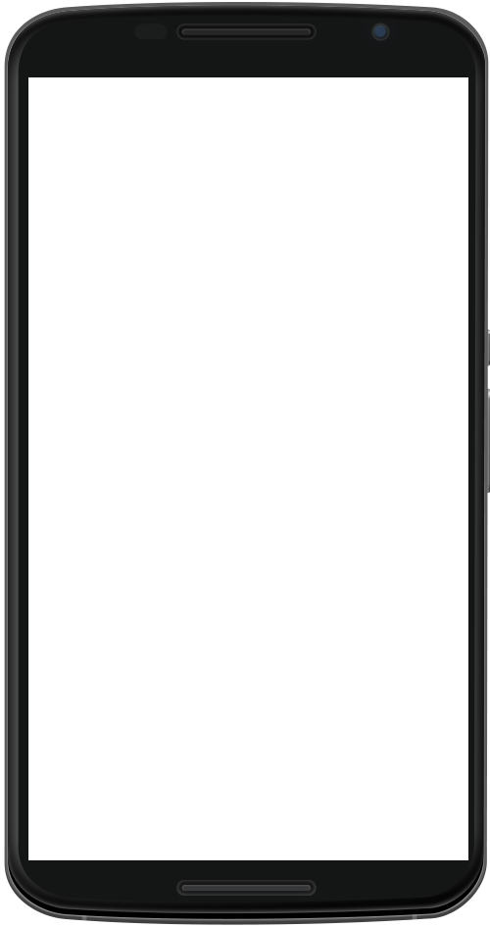
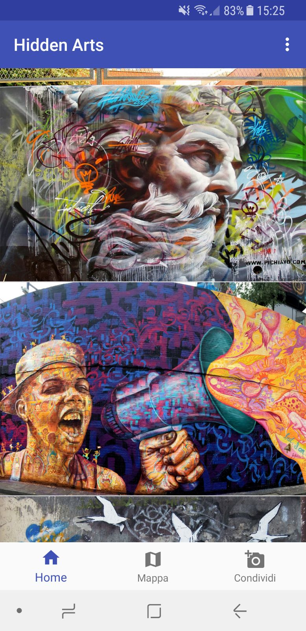
Domain overview
Hidden Arts is a mobile application that allow users to share their favourite street arts around the world.
The user, through the application, will take a picture of a «street art» he likes and select the location.
Once an administrator check the validity of the submission it will be shown on the homepage.

Slide 3
Aim of the project
The goal of the project is the design and the development of the large-scale data management/data processing layer
Part I
Provide application and system requirements (~10 hours)
Choice of the reference technology
Part II
Schema and workload definition (~10 hours)
Cluster and dataset creation (~15 hours)
Schema and workload implementation (~8 hours)

Slide 4

Reference technology: Cassandra
Reasons
The workload is based on a mixed write and read operations. For this reason we decided to rely on Cassandra for data storage and management since it provides very good performance on both of the operations stated above.
It provides an high availability and fault tolerance
CQL

Slide 5
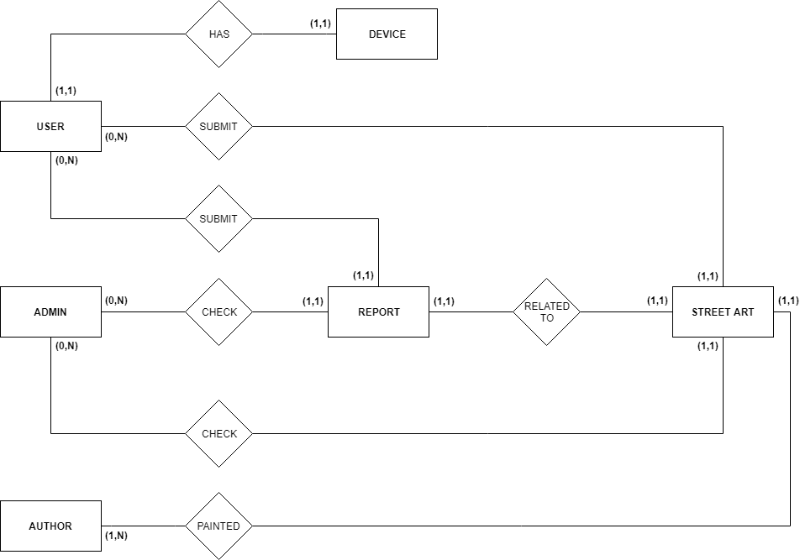
Conceptual schema

Slide 6
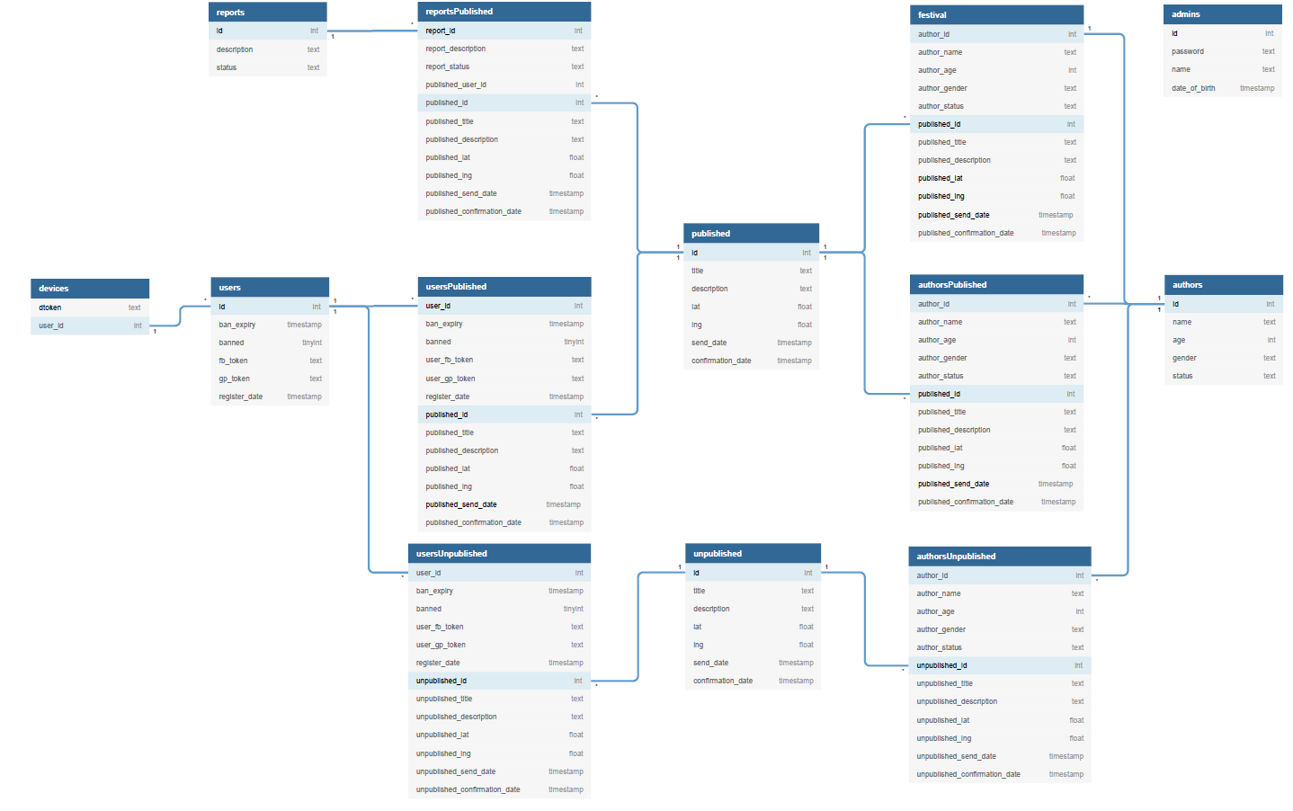
Logical schema

Slide 7
Workload and CQL
Tunable consistency for client requests
LOCAL_QUORUM for strong consistency. A write must be written to the commit log on a quorum of replica nodes in the same datacenter as the coordinator node (Used along with SimpleStrategy).
Cassandra Query Language (CQL)
Schema creation and population
Workload operations

Slide 8




Workload operations: Examples
Creation of a new user’s account
Insert new street art
Select street arts sent by a specific user in a specific range date
Insert new report

